Slide 1
Video Chatting Website

Slide 2
Abstract
Video chatting applications are highly regarded in these times as COVID has distanced many people. A Video Chatting Application helps as one can see and hear the other user. In this Video Chatting Application WebRTC helps develop a connection between the two users in order to have a chat online. Various concepts of web development are used in order to develop a user interface and a platform for the WebRTC connection.

Slide 3
Table of Contents
Sr .No | Content | Page.No
1. | Introduction | 4
2. | Existing Method | 5
3. | Proposed Method with Architecture | 6
4. | Technologies Used | 7
5. | Methodology | 8
6. | Implementation | 9
7. | Sender/Caller UI | 11
8. | Receiver UI | 12
9. | Conclusion | 13

Slide 4
Introduction
Over the last decade, the demand for video conferencing has increased enormously. Video chatting is a software technology that allows group of people anywhere in the world to meet in a virtual room by simply connecting to internet using their personal computer and sharing live webcam. Video chatting has its application in online distance learning, virtual meeting rooms in business, and social networking sites. Online distance learning allows students and teachers to meet in a virtual class room without the need to waste time and money on commuting.
The problem with most video chatting applications is that it has a complicated user interface. The goal of this project is to develop a video chatting website that allows user to enter into virtual chat rooms.

Slide 5
Existing Method
Most of the old technologies for video chatting like iChat, ooVoo are outdated because of many technical reasons like the availability oof the software on particular operating systems, privacy issues, etc. But the new generation of video chatting applications is highly advanced and uses WebRTC . It makes the peer-to-peer connection very easy.

Slide 6
Proposed Method With Architecture
Firstly there must be a sender or the caller and a receiver in a video call.
Thus a separate UI for the sender/caller and receiver must be developed.
As this video chat is hosted on a browser on a particular device, it has to seek permission for the audio and video of that device.
Functionalities must be designed in order to voluntarily disable the audio and video of the user.
A peer-to-peer connection must be developed using a server through which the users can see and hear each other.

Slide 7
Technologies Used
HTML5
CSS3
Javascript
Socket.io (Library)
WebRTC
Chrome(Browser)
VS Code(Code Editor)

Slide 8
Methodology
Using WebRTC to develop a server and establish a peer-to-peer connection between two users. Separate interfaces foe the sender/caller and the receiver. Functionalities for disabling the audio and video.

Slide 9
Implementation
The sender/caller sends a username to the server which is stored by the server.
After that the ‘Start Call’ functionality is used, which sends the ICE candidates to server for the server to store it.
The browser asks the permission for the audio and video of the device before further actions.
Basically a chat room has been generated upto this point.
Whereas the receiver has to type in the username sent to the server to join the call.

Slide 10
Implementation
Now to join the call, the receiver must use the ‘Join Call’ functionality which requests the server the ICE candidates of the sender/caller.
When the receiver receives the request from the server and the ICE candidates of the sender/caller, the receiver sends in its response for the request to the server. (The response is the action of joining a call)
Then the server sends the receiver’s response back to the sender/caller.
In this way a peer-to-peer connection is established in between two users.

Slide 11
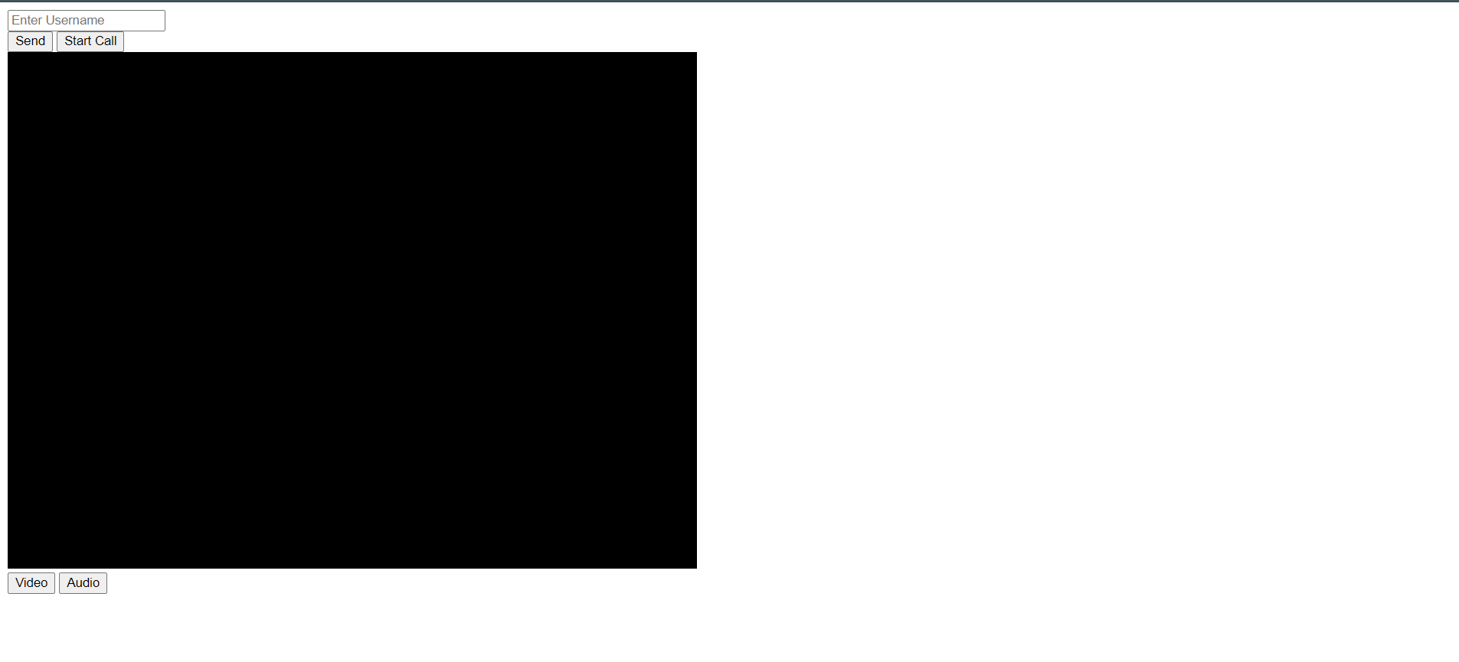
Sender/Caller UI

Slide 12
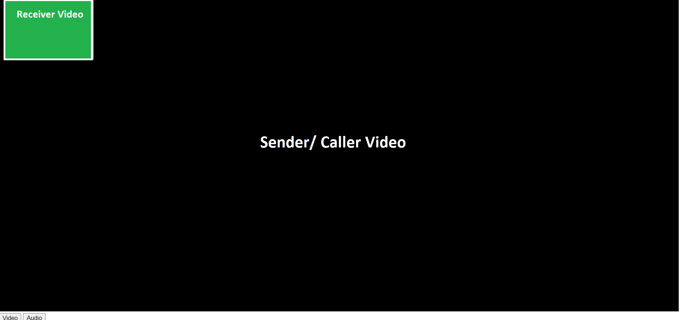
Receiver UI

Slide 13
Conclusion
A video chatting application was developed successfully by using the principles of HTML, CSS and Javascript. WebRTC was used to develop peer-to-peer connection by creating a server.

Slide 14
Thank You!
- Saurabh P. Lohokare

